Slide 1
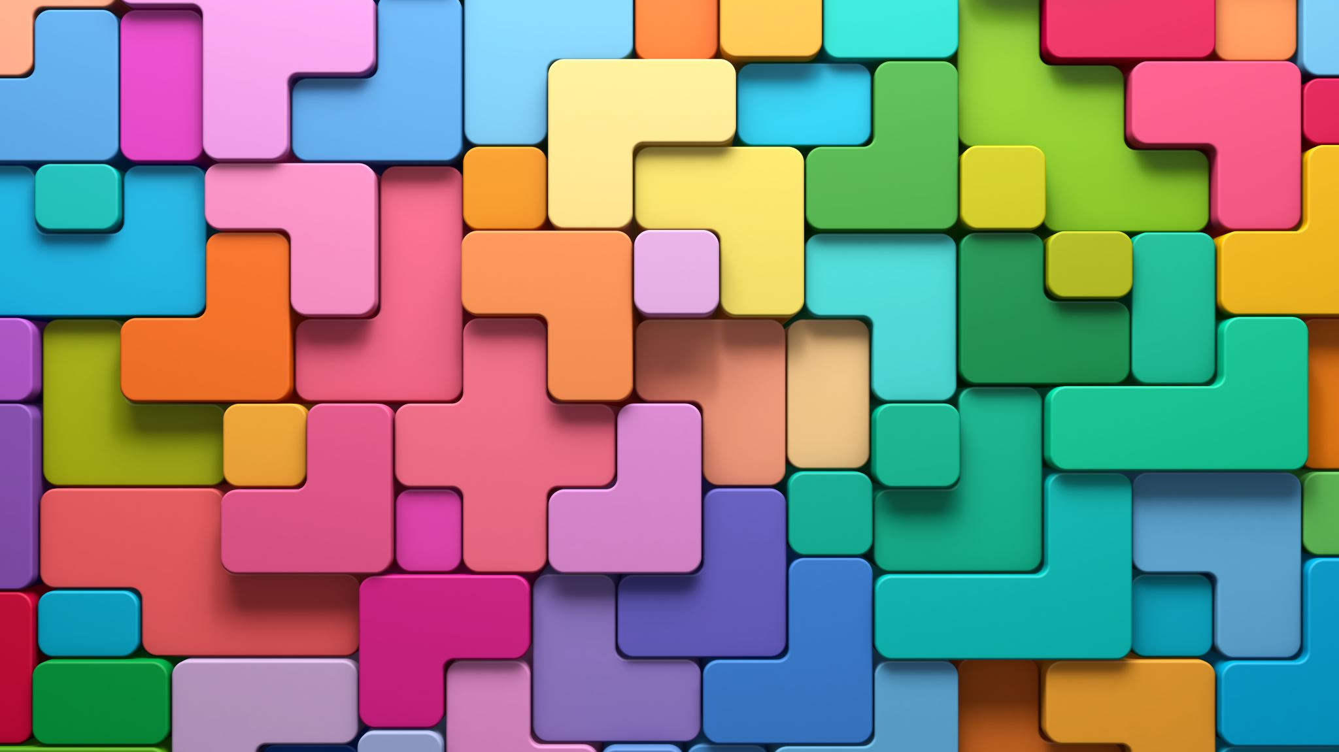
Are you Instagram worthy? An analysis of hotel- and user-generated content
Christian dragin-jensen, Business academy southwest
Mia Post-Lundgaard Business academy southwest
Oliver schnittka University of southern denmark

Slide 2
Introduction
Over 60% of travelers share their own content from holidays or travels on social media (Statista, 2019)
Hotels are increasingly interested in staging the scene to provide their guests with an instagrammable moment (Anderson, 2017)
Source: Guldsmeden Hotels, Instagram

Slide 3
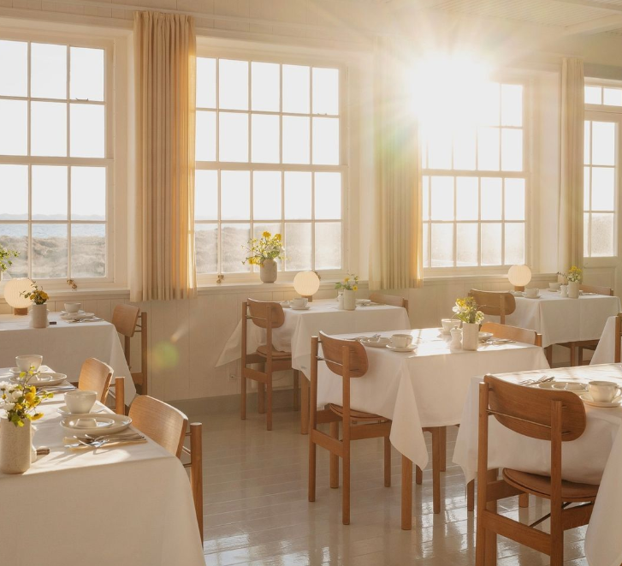
Social Media: An omnipresent tool for hotels and their guests
Instigates dialogue between guest and hotel
Hotels’ proactive presence in the social media verse is a must
Activating customer engagement on social media plays an important role in increasing purchase intentions for hotels (Yoong & Lian, 2019)
Source: Svinkløv Badehotel, Instagram
Notes:
Not only create and share knowledge of its product and services, but to also permit and engage (potential) consumers in generating content and providing insights on what matters to them most when travelling and staying at their hotels.
Social media has transformed how firms relate to their markets and consumers (Garrido-Moreno et al., 2018). Social media, a “set of online tools that supports social interaction between users, facilitating the creation and sharing of knowledge, and transforming monologue (company to customer) into dialogue” (Hansen et al., 2011, p.12), has opened a myriad of pathways for organizations to enjoy a direct link to their customers.
This is particularly the case for hotels, as they characteristically make an intensive use of information (Gonzalez et al., 2019), and social media serves as a powerful medium for organizations to bring information quality, credibility and authenticity to the foreground (Kapoor et al., 2018).
Social media also offers the unique discourse of providing swathes of user-generated content, providing in-depth customer insights to the current state of hospitality and tourism, and as Han and Lee state, “at a time when much more innovative and exciting hospitality experiences are preferred by consumers, image-based, user-created content can help businesses catch up with the changing demands”

Slide 4
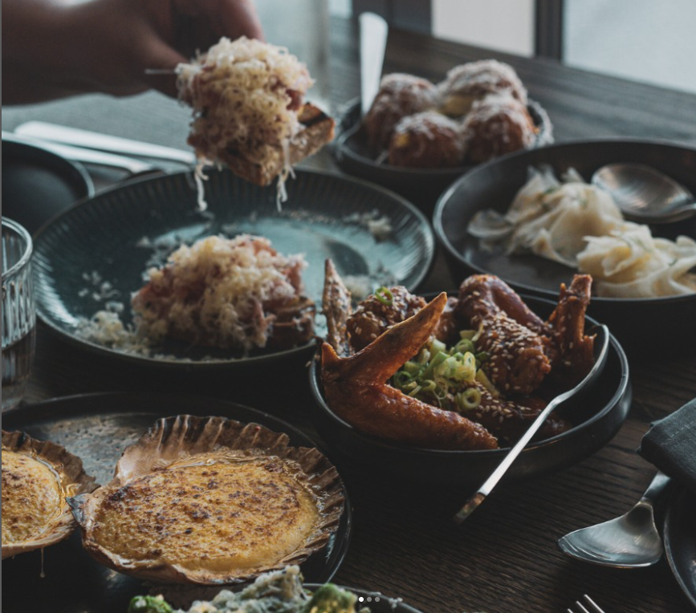
Instagram: A visual storytelling tool for travelers and hotels alike
Instagram has 1.28 billion users as of 2023 (Statista, 2023)
Fourth most popular social media platform in the world – behind only Facebook, YouTube and WhatsApp (Statista, 2022)
Engagement is highly dependent on the platform (Voorveld et al., 2018)
Source: A Place to Hotels, Instagram
Notes:
“engagement is highly dependent on the platform….earlier empirical studies lump all digital platforms together and so fail to appreciate that, based on engagement dimensions, each of these platforms comprises a substantially different makeup in terms of experience” (Voorveld et al., 2018, p. 50)

Slide 5
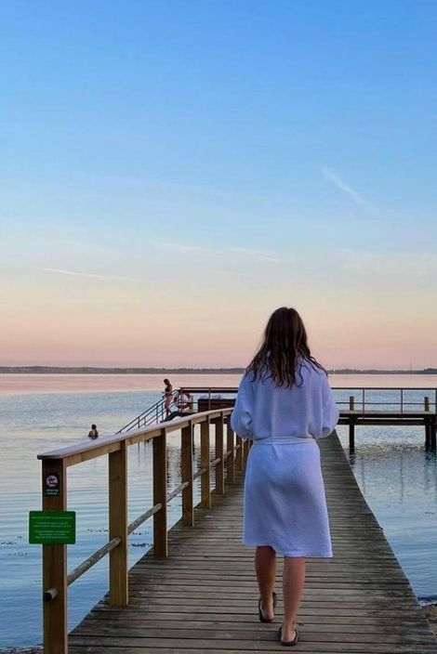
Research Questions
Paucity in research: type of content generating likes and engagement
Researchers (e.g., Aydin, 2020; Lu et al., 2018; Varkaris & Neuhofer, 2017) stress the need for future research to delve into Instagram to better comprehend:
impact on the dynamic processes of lodging and travel, both due to changing preferences of consumers and Instagram’s ability to provide unique video and photo content;
what photos and videos travelers take, and what particular spots are favored in order to better design experiences and understand the preferences of consumers.
RQ1: What type of content created by hotels generates most likes on Instagram?
RQ2: What type of UGC of hotels generates most likes on Instagram?
Source: Bergholdt18, Instagram

Slide 6
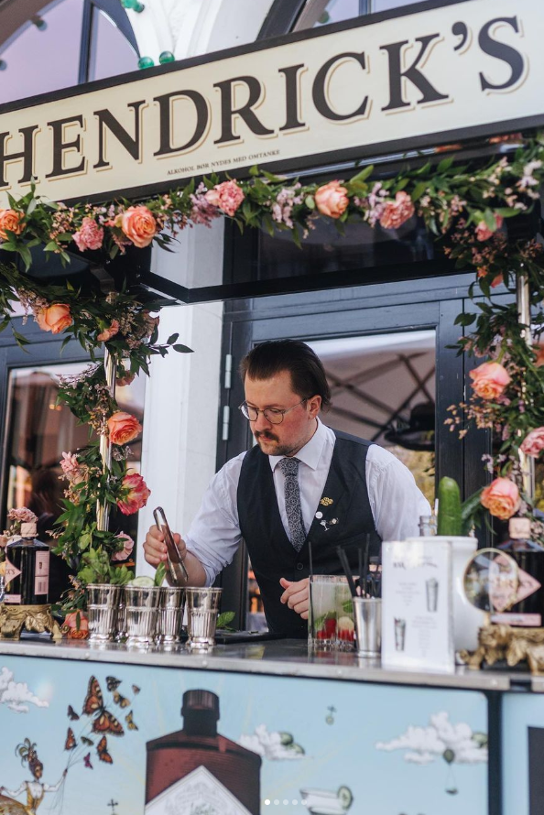
Our study
Quantitative content analysis
25 Danish hotels
conference, city hotel, resort, inn/castle, beach hotel
Capital city region, Zealand, Southern Denmark, Mid Jutland, and Northern Jutland
Data collected (all posts by hotels and users)
8th of June – 11th of July 2022
N = 1,031 posts were collected (hotels = 602; users = 429
Intercoder reliability (Lombard et al., 2002)
Sneak peek of preliminary interviews of hotels
Source: Nimb Hotel, Instagram

Slide 7
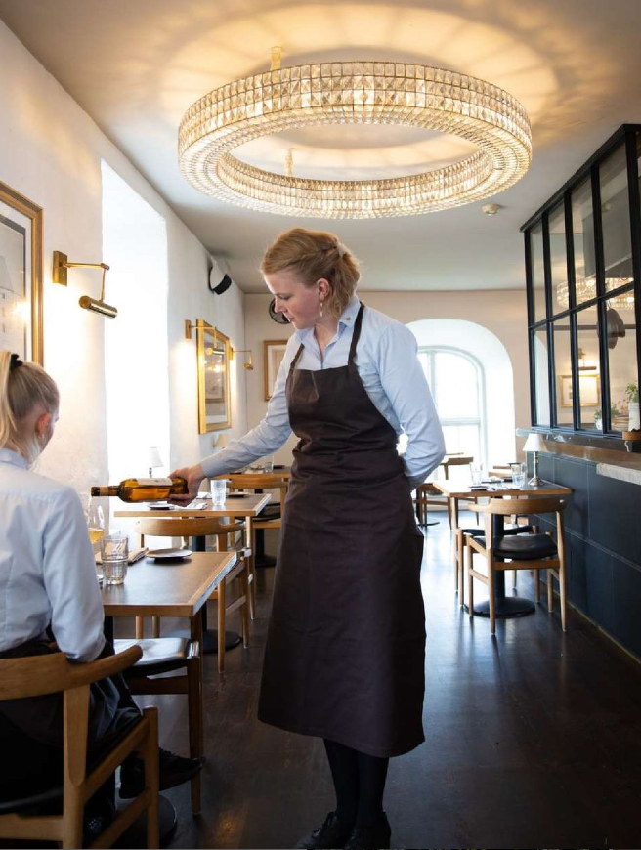
Overview of Categories
Category | Sub-categories | Hotel (supply) / UGC (demand)
Content category | Video (Reel) | Both
 | Hotel Story | Hotel
 | UGC in Hotel story | Hotel
 | UGC + Hotel story | Hotel
 | Image | Both
 | Multiple images | Both
 | Video + Multiple Images | Both
Type of post | Sales-related | Hotel
 | Informative | Hotel
 | Other | Hotel
Physical attributes of hotel | Ext. views of hotel | Both
 | Int. views of hotel (general) | Both
 | Lobby | Both
 | Room | Both
 | Bathroom | Both
 | Food and Beverage facilities | Both
 | Conference facilities | Both
 | Spa/pool/beach facilities | Both
Service offerings | Events/happenings | Both
 | Wedding | Both
 | Accommodation | Hotel
 | Food and Beverage | Both
 | Spa (treatments) /Pool/Beach | Both
 | Other services (e.g., turndown) | Both
 | Sustainable services | Both
People | Employees/Staff | Both
 | Guests | Both
 | Selfie | UGC
 | Other | Both
Branding | Hotel brand | UGC
 | Other brand | UGC
Communication/Information | Credentials | Both
 | Corporate Social Responsibility | Both
 | Safety/Security | Both
 | Off-site experiences | Both
 | Travelling | UGC
 | Job posting | Hotel
 | Other | Both
Likes | At time of post | Both
 | In August 2022 | Both
Source: Dragsholm Slot, Instagram

Slide 8
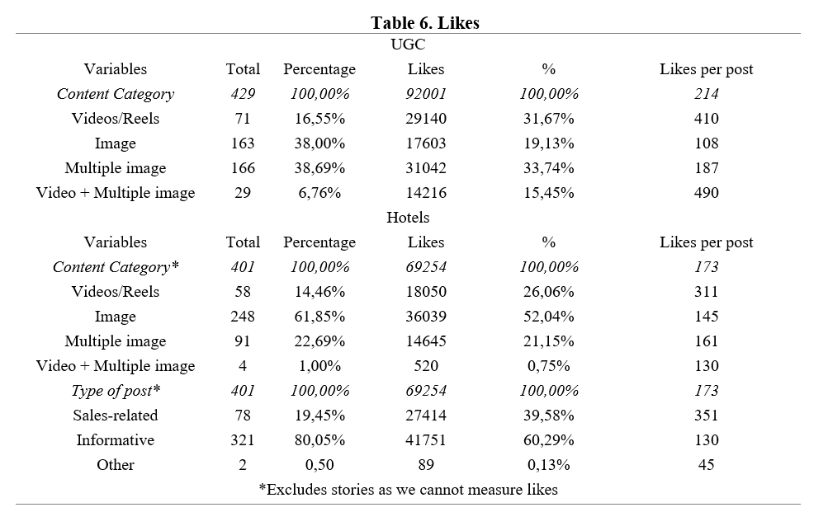
FINDINGS
1. Format of content:
Video is King!
Also paired with multiple images
2. The characteristics of posts:
Sales-related posts generated more likes per post than that of informative posts
Notes:
Noteworty that salesrelated post generates amount of likes pr. post as they only acount for les than 20 % of total amount of posts
Sales – counterintuitive – not nessecarily engagement in generel is not related to salesrelated posts (we do not like to be sold to) – but here we see it.

Slide 9
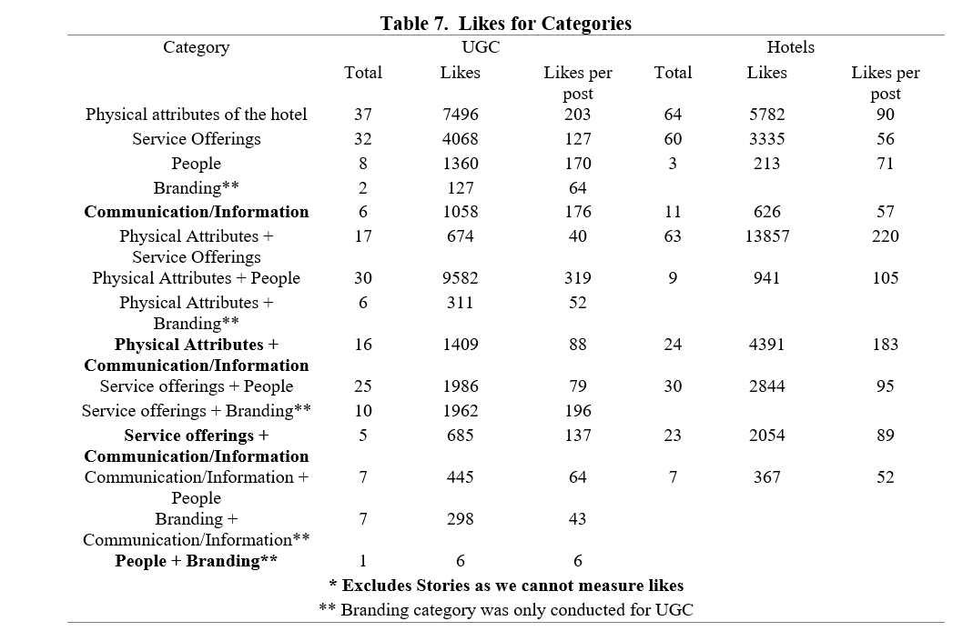
3. The content:
A post on IG from a hotel is more likeable if it features more than one hotel attribute (physical attributes + service offerings or people)

Slide 10
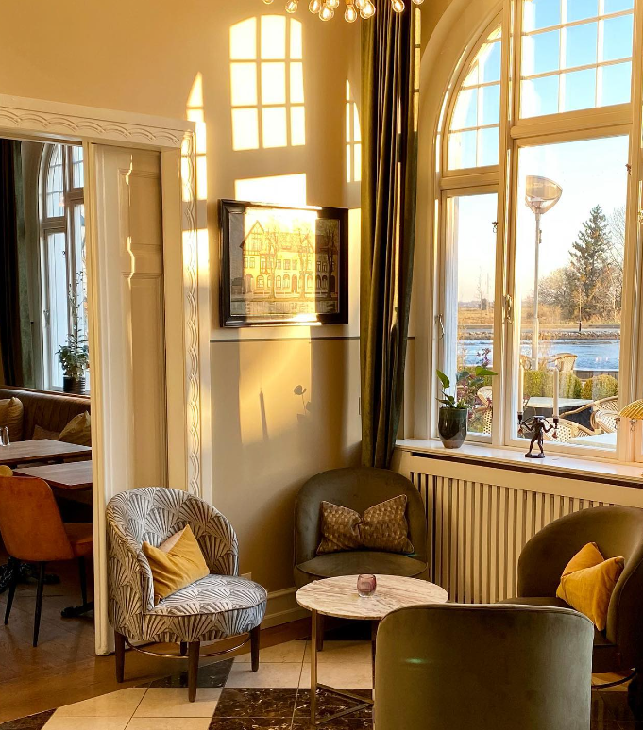
Figure 2. Volume of posts by percentage
Source: Hostrups Hotel, Instagram

Slide 11
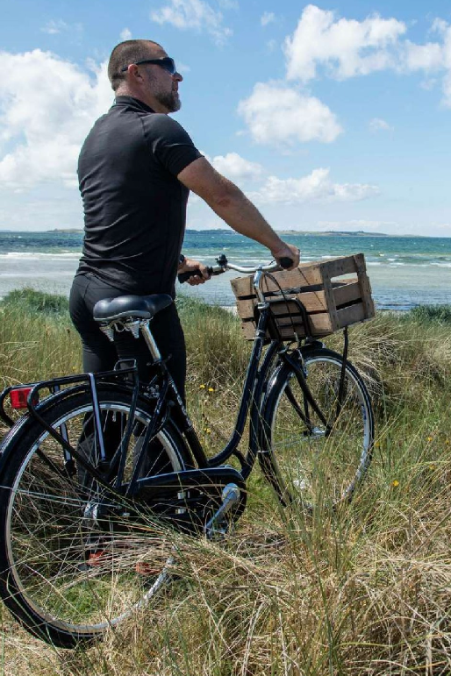
Preliminary results from interviews
Explanatory sequential design (Ivankova et al., 2006)
Work in progress (N=6)
Semi-structured interviews with hotels
Those in charge of the IG profile
Source: Dragsholm Slot, Instagram
Notes:
Kvantitative data followed by kvalitative data

Slide 12
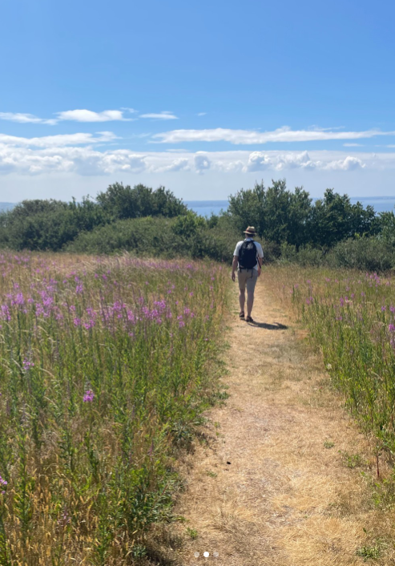
Preliminary results from interviews
What is Instagramable?
The aesthetics – showing the best of our DNA
Guests buying into the DNA / Values
An extension of the customer's own image
Hotels have IG spots – some created and some are organic
Know them and utilize them – create them, if you must!
Key Touch Point during customer journey before, during and after
Influences guest decision making process and purchasing intention
IG not seen as a sales channel
Use of influencers instead of paid media
Source: Dragsholm Slot, Instagram
Notes:
Inspiration
Security
Stamp of approval

Slide 13
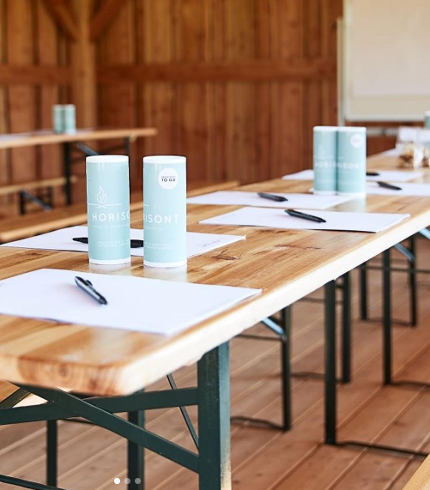
Avenues for future research
What makes a space ”instagrammable” ? How is that defined?
Weighing in on the content ”library”
Source: Horisont Hotel og Konference, Instagram

Slide 14
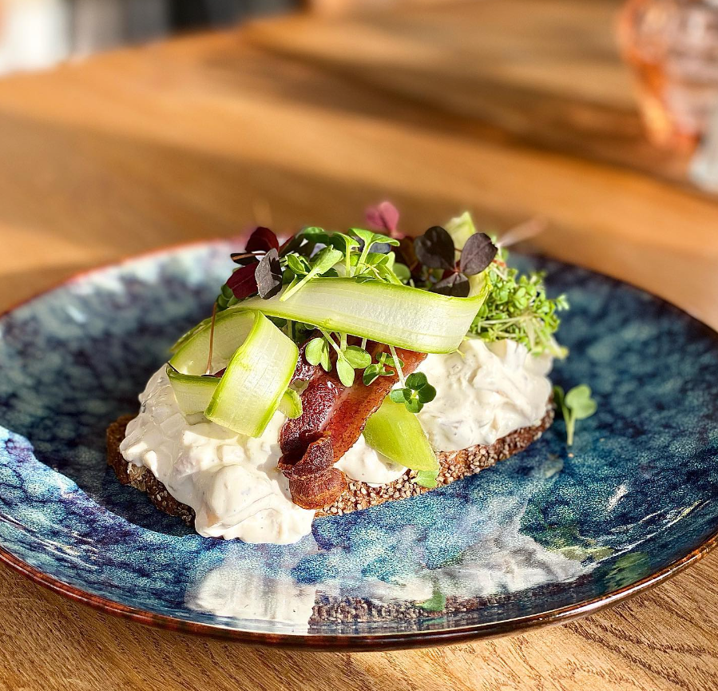
Limitations & Considerations
Statistical analyses
Lack of DV
Segmenting UGC based on target groups
Franchise and chain hotels vs. stand-alone hotels
Source: Hostrups Hotel, Instagram

Slide 15
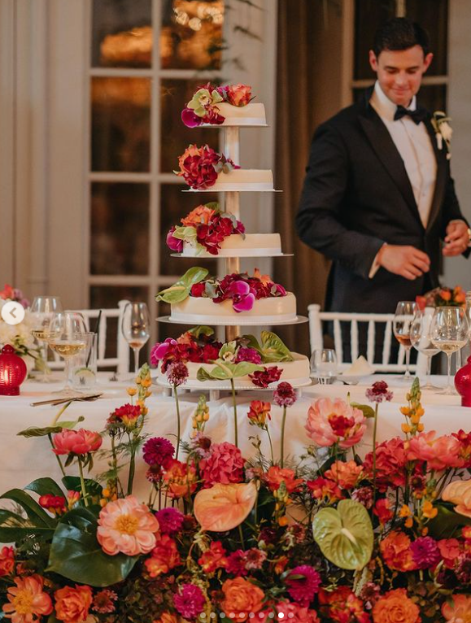
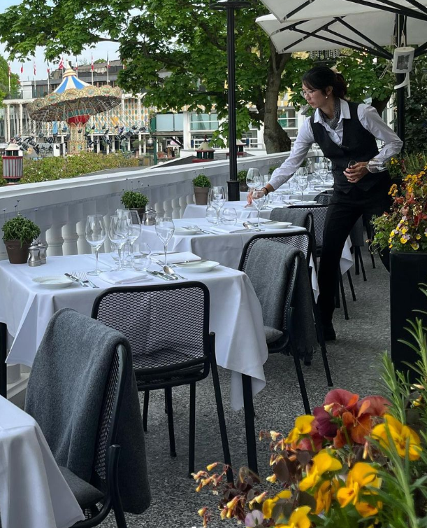
Thank you! Questions?
Source: NIMB Hotel Copenhagen, Instagram

