Slide 1
Event Innovation in Times of Uncertainty
Christian Dragin-Jensen

Slide 3
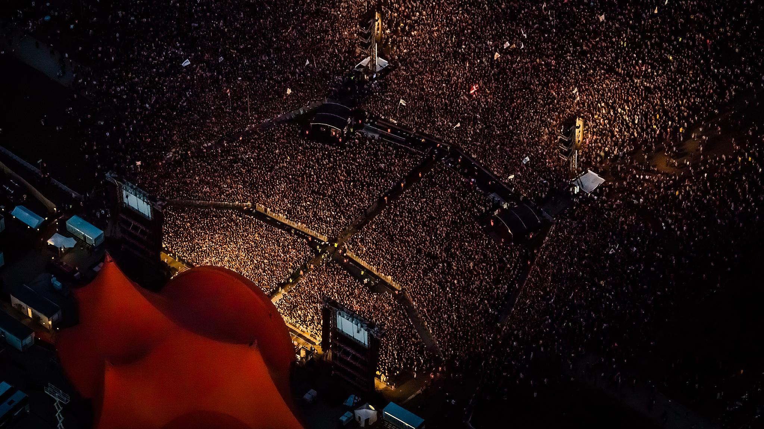

Slide 4
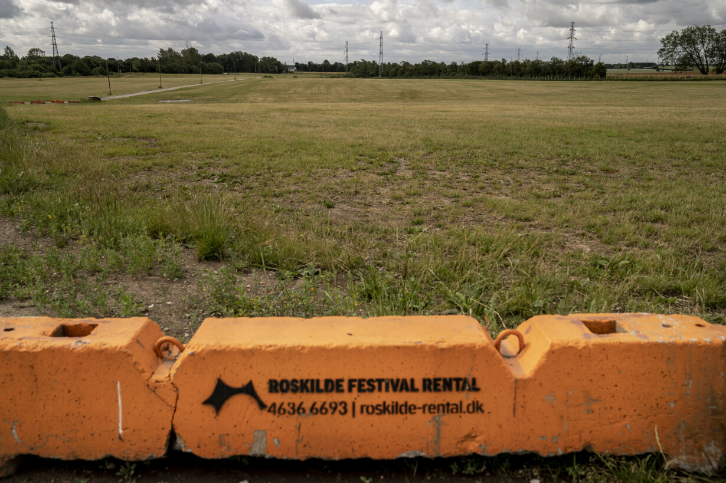

Slide 5
UGH…we KNOW!

Slide 6
Band-aid solutions…

Slide 7
Yet some still went ahead…WHY?

Slide 8
And some had GREAT SUCCESS!

Slide 9
Calls for an investigation!
We therefore wanted to answer Armbrecht et al.’s (2020, p.8) call for event and festival research during the COVID-19 pandemic to explore “the importance of understanding failure, crisis, innovation and recovery”.

Slide 10
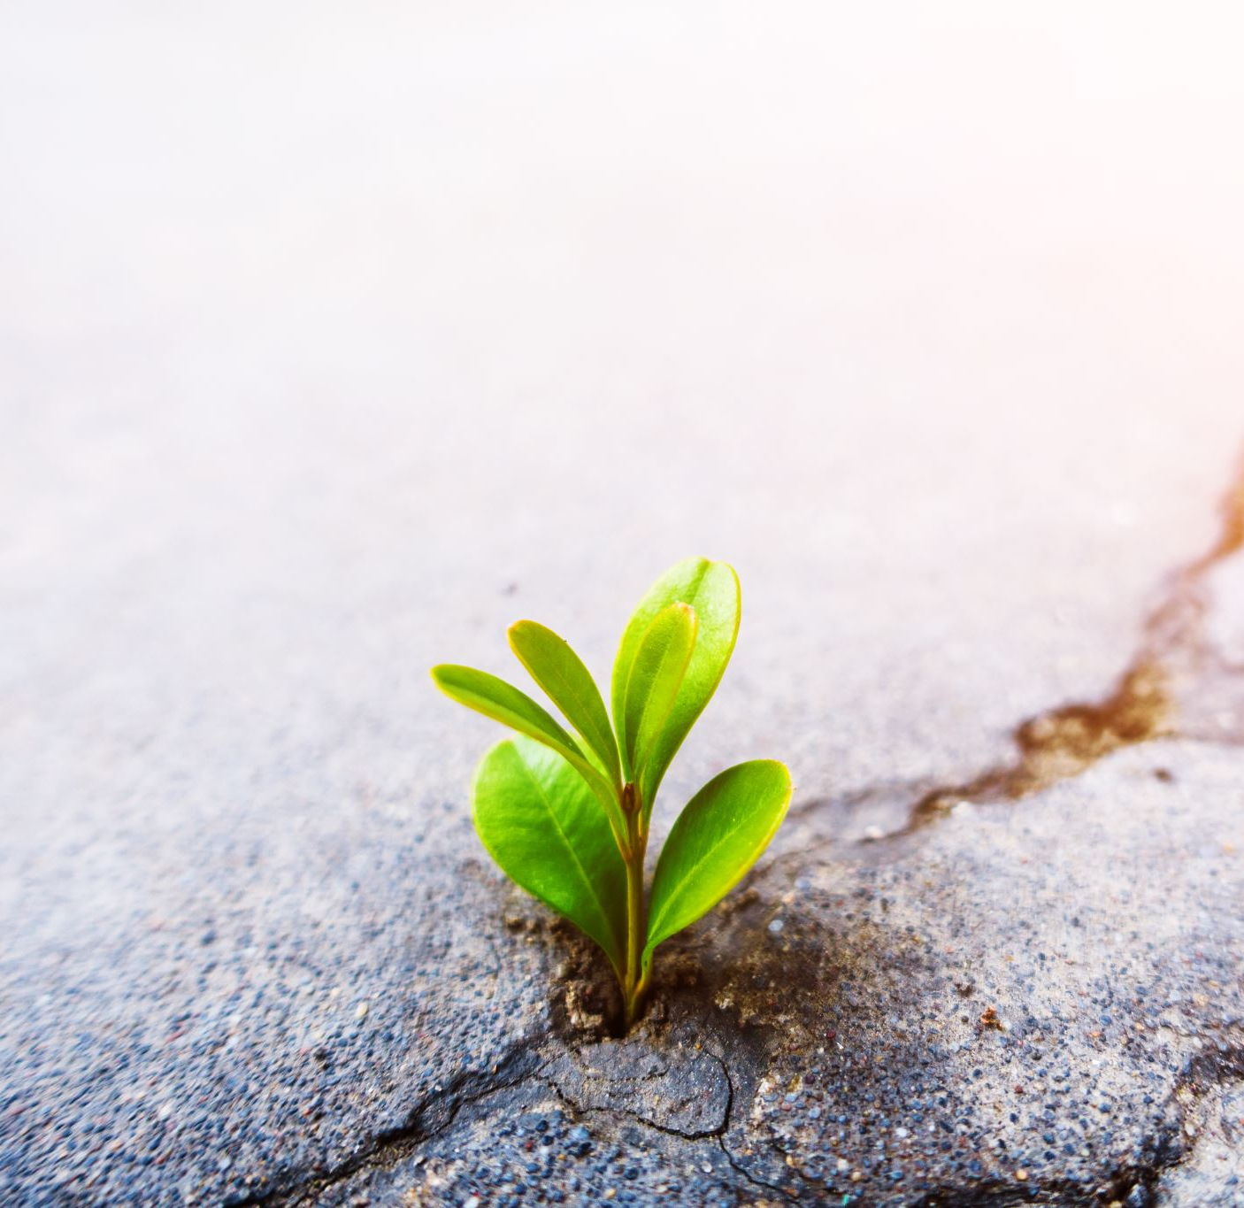
Resilience and Innovation: Key concepts
Prior to the COVID-19 pandemic, most innovations in the tourism, events and hospitality industries were aimed to increase profits, beat competitors, or both.
(Hjalager and Kwiatkowski, 2018)
The global pandemic has caused many companies to set a new innovation target: resilience.
(Sigala, 2020)
Defining Resilience: "a capacity to prepare for, to respond to, or to bounce back from problems or perturbations and disturbances“
(Chandler and Coaffee, 2017, p.4)

Slide 11
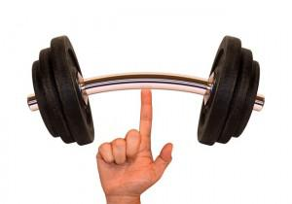
On resilience….
Two main ‘types’ of resilience (Dovers & Handmer, 1992):
Reactive resilience:
Approach to the future is to maintain the status quo and the quest is for constancy and stability
Key words: Resistance, Bounce-back, Reactive, (Supardi & Hadi, 2020;Twigger-Ross et al., 2011)
Proactive resilience:
Inevitability of change is accepted and a system is created that is capable of adapting to new conditions
Key words: Adaptation, Transformation, Dynamic (Supardi & Hadi, 2020;Twigger-Ross et al., 2011)

Slide 12
On innovation…
Analysis conducted by the OECD suggests that innovation is a multifaceted phenomenon shaped by a plethora of factors and interactions (Roberts and Tõnurist, 2018).
BUT! Two are most decisive:
Whether the innovation has a clear intent/objective regarding what it is trying to achieve (i.e., directed innovation)
Whether it is primarily related to the discovery of and responsiveness to (proactive or reactive) externally generated change (undirected innovation)
Result in types of change: "sustaining", "transformative", “adaptive"

Slide 13
Our take….

Slide 14
Our take….
Sustaining innovations – short-term, highly reactive responses to a shock (i.e., COVID-19) that aim to rebalance the system after an incident. By nature, these innovations are driven by external situations and are devised out of necessity. They are a product of the preceding conditions and the first consequences of a “shock”.
Adaptive innovations – embrace reactions after the initial shock and aim to adapt the system to the current situation; they intend to reduce the risk of failure by ad hoc, reactive and systematic adjustments. These are driven by both internal and external factors. These innovations are based on an awareness that matters are evolving and not always as expected.
Transformative innovations – activities showing the ability to cross thresholds into new development trajectories. These anticipatory actions have voluntary and bottom-up natures. In such cases, innovations involve recognizing not only what might work but also what is possible in a given condition.

Slide 15
Our study
Builds upon insights offered by 4 cases (case-study approach)
Semi-structured interviews and event analysis (official documents, media coverage, participant reviews and social media sites)

Slide 16
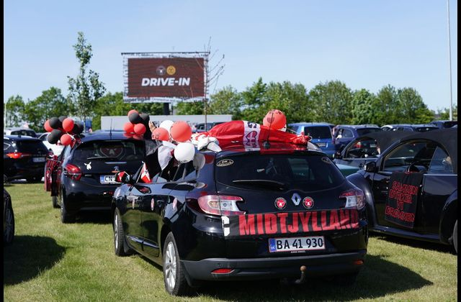
FC Midtjylland: Drive-in Football

Slide 17
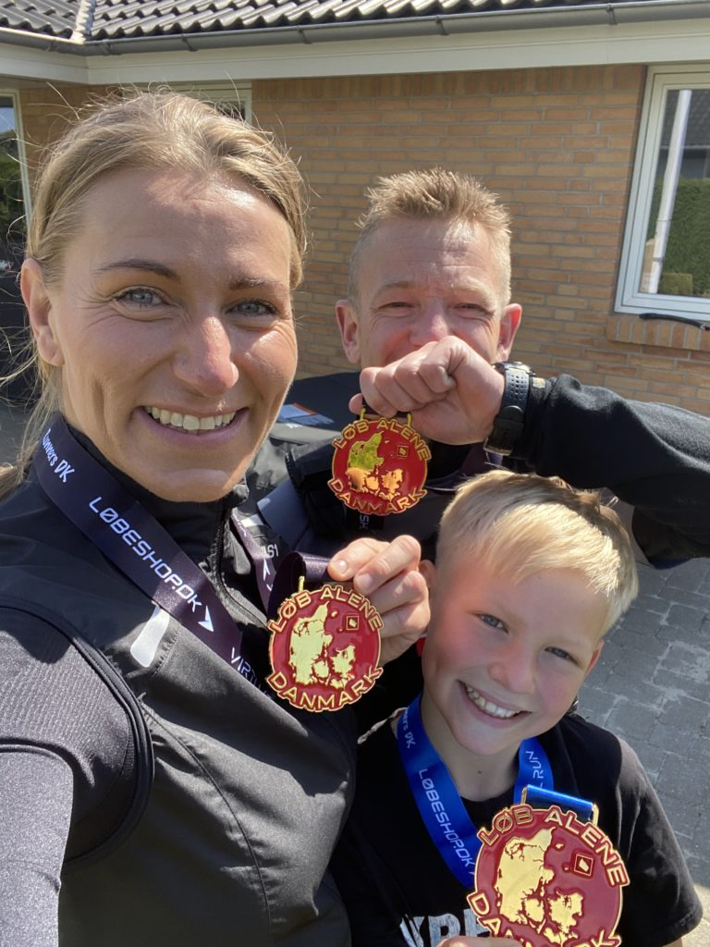
KRIXRUN: Run Alone Denmark (Løb Alene Danmark)

Slide 18
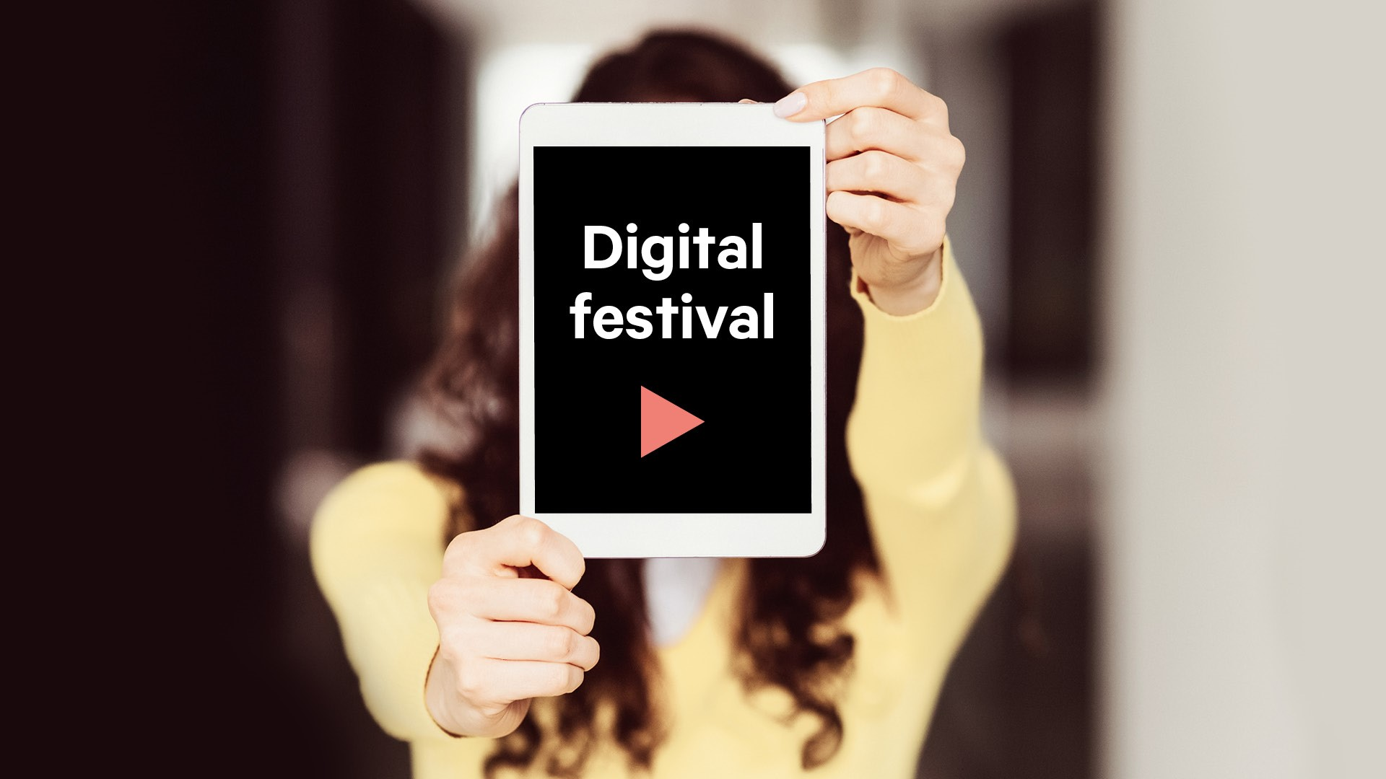
Bergen International Festival

Slide 19
Steinkjer Festival

Slide 20
Overview of innovations
Event | Sustaining innovation | Adaptive innovation | Transformative innovation
Steinkjer Festival | Live-streamed festival | Artists present on site for stream Festival food and beverage ‘packages’ for sale, so audiences could create ‘mini-festivals’ at home. | Movie-quality production of streams as a marketing tool. Closer integration with smaller venues of community.
Run Alone Denmark | Created a virtual run during longest period of lockdown. | Online studio with hosts Collaborated with other running networks to create event. | (New) community building: new website and booking platform. App development for user co-creation.
Drive-in football | Streamed football match outside. | Car caravan trip between club’s two cities for fans Giving back to the fans: Global media attraction and brand building. | Designed new experience for football fans to (safely) experience together.
Bergen International Festival | Streamed festival | One-month transition from completely physical to digital festival in 2020. | Hybrid launch of event in 2021. Digital performances were designed and executed with camera in mind. New booking ticket system developed: geographical market expanded. Local audiences could book private performances in public areas. Art sent to atypical locations around the city.

Slide 21
Sustaining, Adaptive and Transformative Innovations: Insights

Slide 22
User-driven Innovation: Customer and organization values at the forefront
Organizers critically reflected on “Why are we here? (as an organization)”, and “What do our customers need?”
Steinkjer Festival:
“When the government restrictions in March (2020) came out, we immediately knew we had to cancel our festival. But then we sat down together, and asked ourselves – why are we here? We host festivals, not because we ‘just’ want money, we do it because we love festivals and we love music – we are not only personally motivated in this, but we also have a responsibility to our community.”

Slide 23
Fostering Innovative Environments
Ability to reach such solutions (rapidly) stemmed from the organizations’ well-tended innovative and organizational environments (+ having a war chest)
Flat and horizontal organizational structures, where not only opinions and ideas were frequently discussed in plenum, but also major decisions were reached
Risk-taking was seen as not only necessary, but critical.
FC Midtjylland:
“We are FC Midtjylland. There are expectations of us to be innovative – how we play football, how we recruit players – so why not how we interact with our fans and design our events? Football is a traditional industry, and we want to break that mold. I am always able to call in the team to discuss any idea (even if it seems crazy), and if we want to go with it, I know the director of the club is right down the hall, where I can easily knock on his door.”

Slide 24
Digital Technologies: An innovative strategy to enhance the experience platform and to redefine event space
All agreed that entirely digital versions of their events were not substitute products, but rather the means to enhance their experience platforms.
Most significant overlying transformation that using digital technologies wrought was the redefining of what an event space is!
Bergen International Festival:
“We discovered this year that there is a willingness to pay for digital streams of our productions. But, anyone can stream a production – there is nothing unique or experiential about this. To make this work, you need to make it a world-class, movie-quality production: bring the viewer into areas they would never be able to access if they were there present; design the entire performance with the camera in mind”.

Slide 25
Government assistance: Catalyst or Crutch?
Discussion:
What role should the government play in this?
Can they play a role?

Slide 26
Thank you! Questions?

