Slide 1
Youth Fashion Summit 2018 - 2019
Introduction to pre-assignment
Notes:
Introduction webinar Tuesday 7th of March

Slide 2
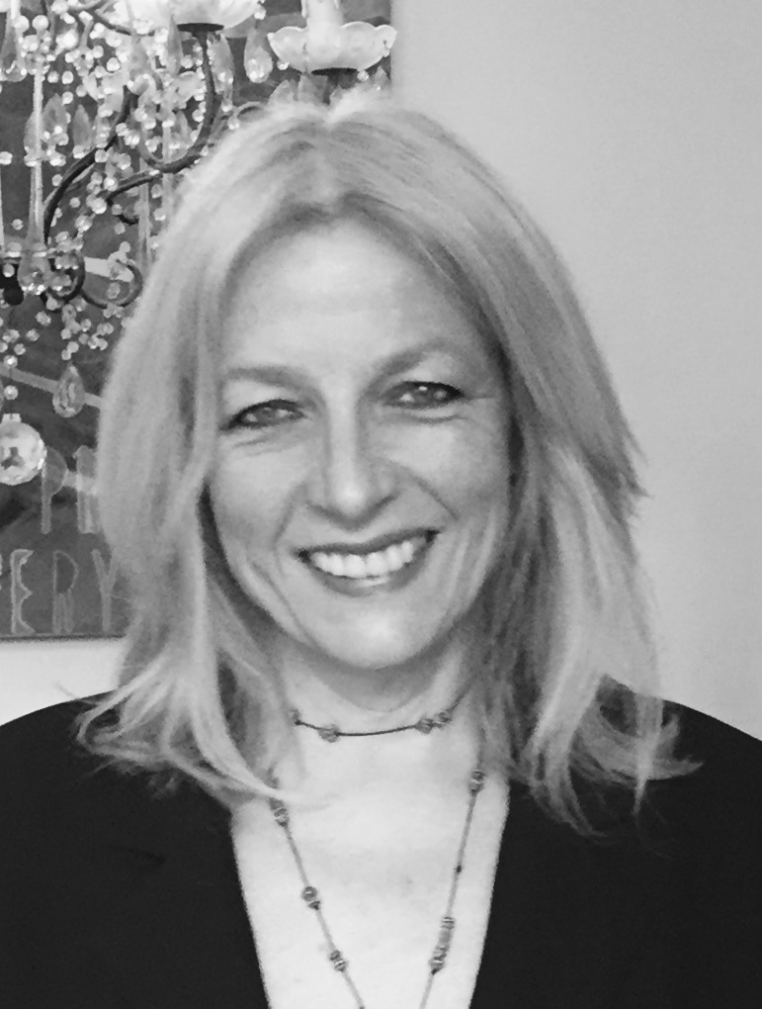
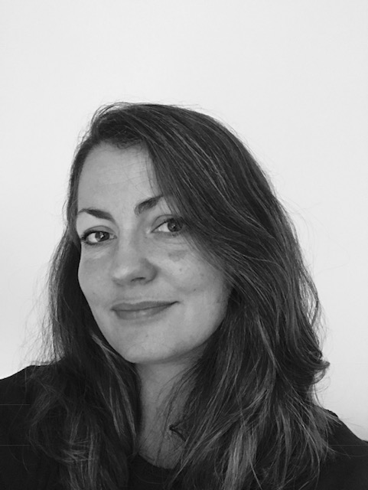
Presented by:
Jane Burchard
Lecturer KEA: Facilitator and project Developer
Penille Dalmose
Lecturer KEA: Facilitator and project Developer
Notes:
Lecturer at the Sustainable Fashion, BA Design & Business
Copenhagen School of Design & Technology (KEA)
Fashion Designer from Designskolen Kolding.
Focus areas are Hand craftsmanship, Slow fashion, Sustainable designmethods, Sustainable Value Chain Thinking and
The Sustainable Development Goals
Lecturer at the Sustainable Fashion, BA Design & Business
Copenhagen School of Design & Technology (KEA)
Fashion Designer from (DDS) Royal Danish Academy of Fine Arts Schools of Architecture, Design and Conservation.
Focus areas are People, Planet and Prosperity, Sustainable Materials, Circular Design, Sustainable Design Methods, Sustainable Value Chain Thinking and The Sustainable Development Goals

Slide 3
Pre-assignment

Slide 4
Content
BEFORE COMING TO COPENHAGEN
PREPARATION
RESEARCH
OUTCOME
PRESENTATION

Slide 5
BEFORE
COMING TO
COPENHAGEN
Before coming to Copenhagen you must prepare an assignment that incorporates the
given SDGs.
The idea with this assignment is to prepare you for the workshop days and to create
a common awareness of the SDGs in your country; the assignment will serve as a topic of discussion and inspiration for further work.

Slide 6
PREPARATION
Read the text linked as it pertains to your assigned Sustainable Development Goal (SDG):
either SDG#3 Good health and wellbeing or SDG#5 Gender equality.
Refer to the webinar from the March 20, 2018 (link below)
https://sustainabledevelopment.un.org/post2015/transformingourworld/publication
● Webinar 2, at 4. pm on March 20, 2018:
https://attendee.gotowebinar.com/register/7957521181724144131
(​Introduction to United Nation and the SDGs)

Slide 7
RESEARCH
Based on your assigned Capital, you must research the current conditions and the
implementation of SDG #3 or #5 in your country and give examples through visualization
and keywords. It can be within industry/company/organization or in society.
The examples can be either positive or negative, it has to relate to your SDG and the Capital you have been assigned.

Slide 8
OUTCOME
Create and visualize at least one A3 Mood Board (Horizontal) that shows your examples from the industry/ company/organization or society you have chosen to research.
The Mood Board should be visual with a few key words.

Slide 9
PRESENTATION
You have to bring, present, and discuss your key points from your Mood Board/s
in your group of 14 persons on the first day of YFS.
Each student has 5 minutes to present their Mood Board
All Mood Boards will be displayed and shared with all participants.
Further instructions will follow on the first day of the workshops.

Slide 10
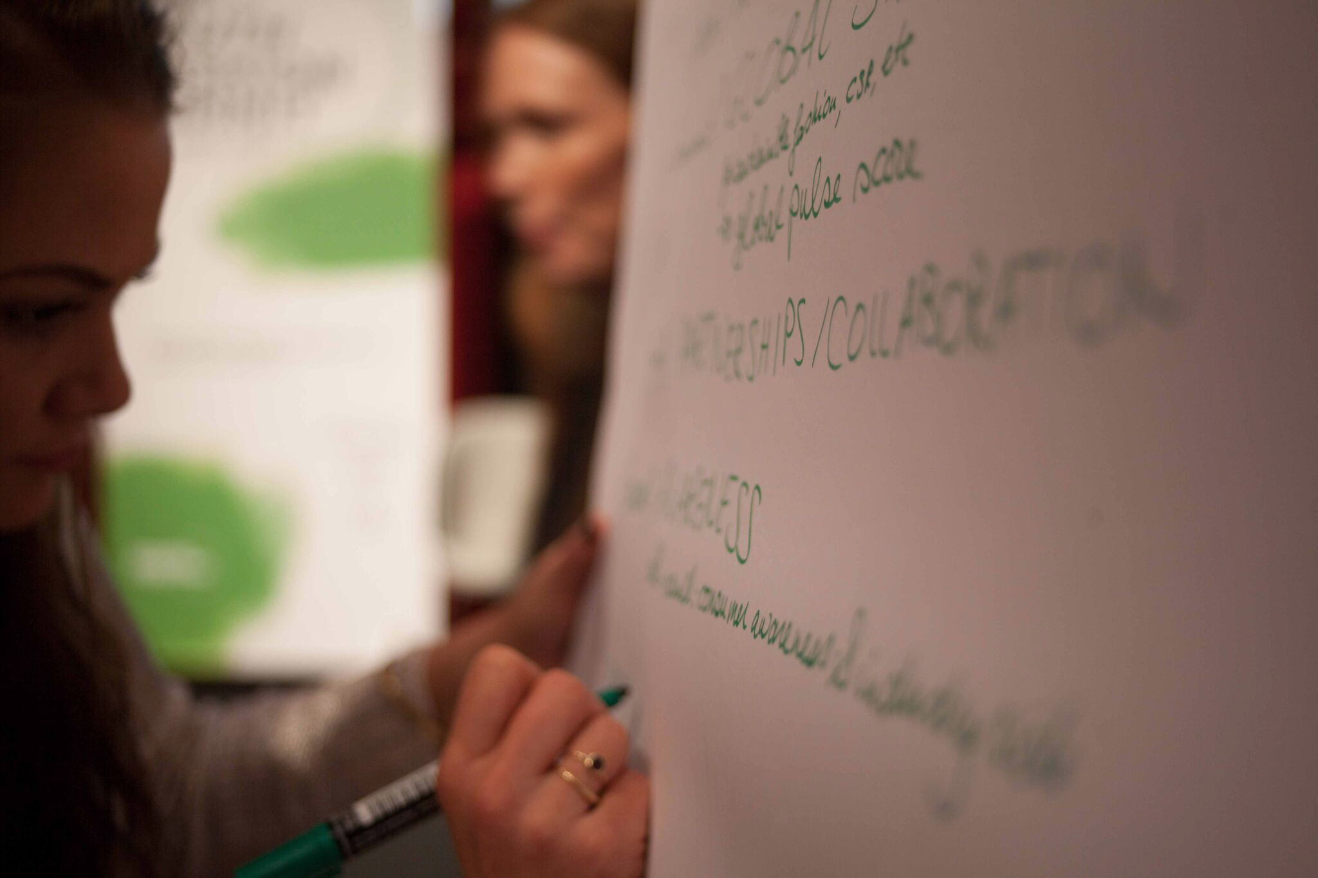
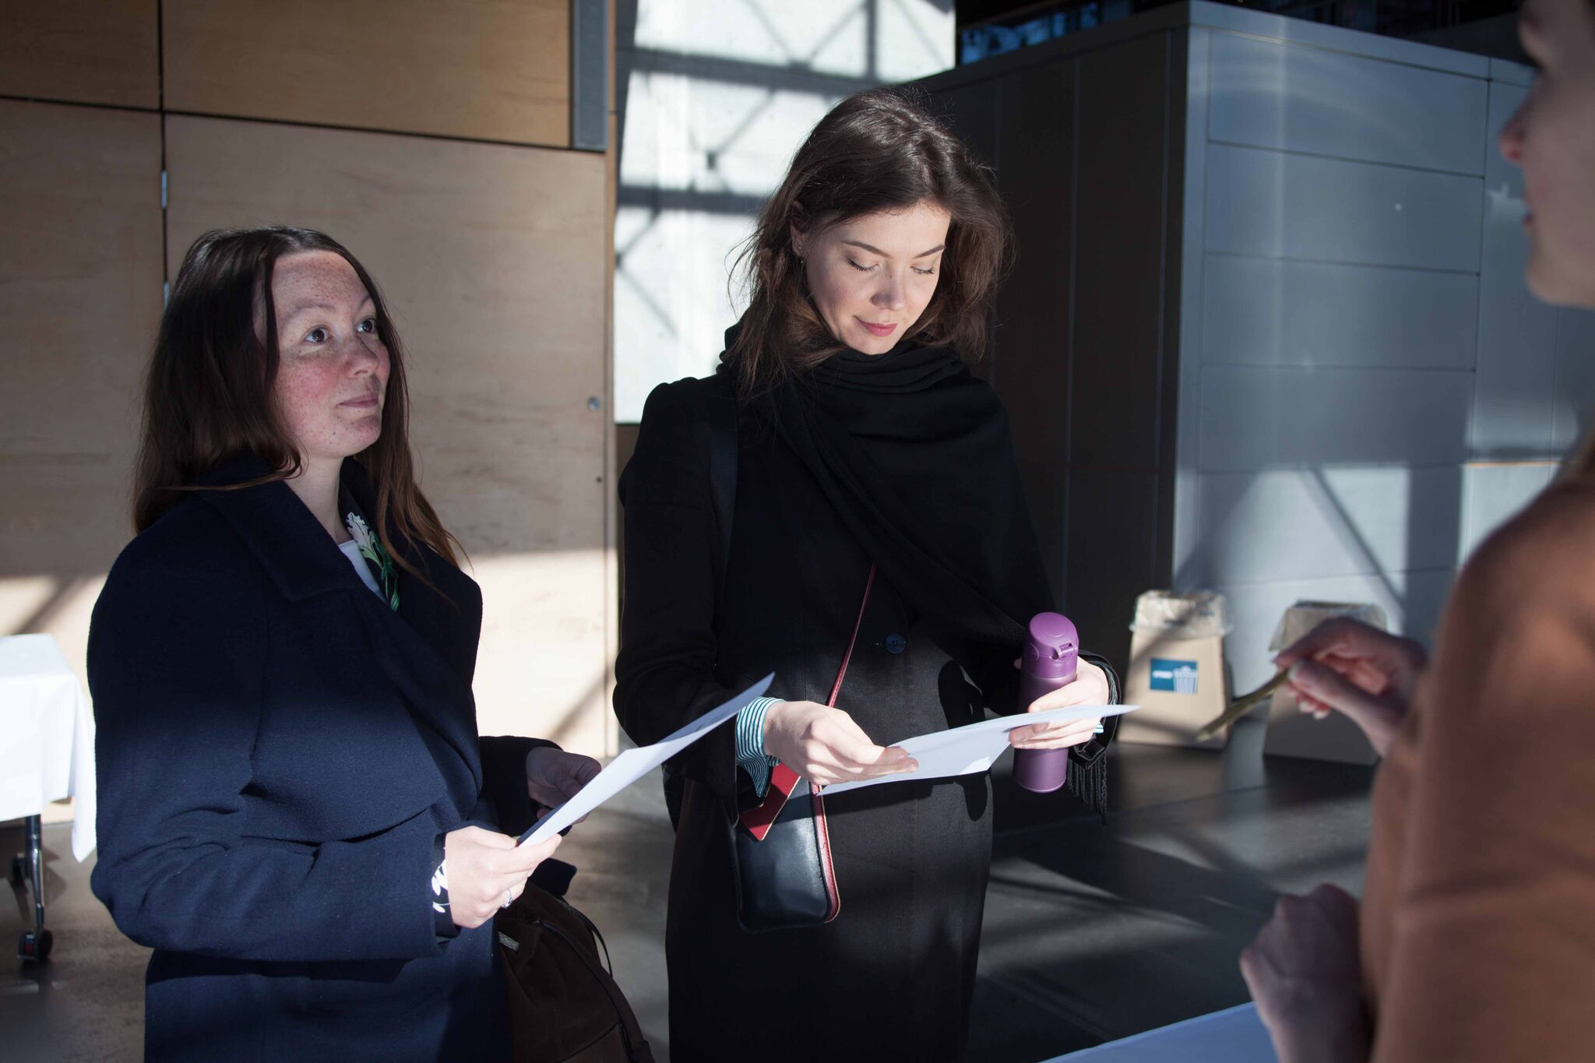
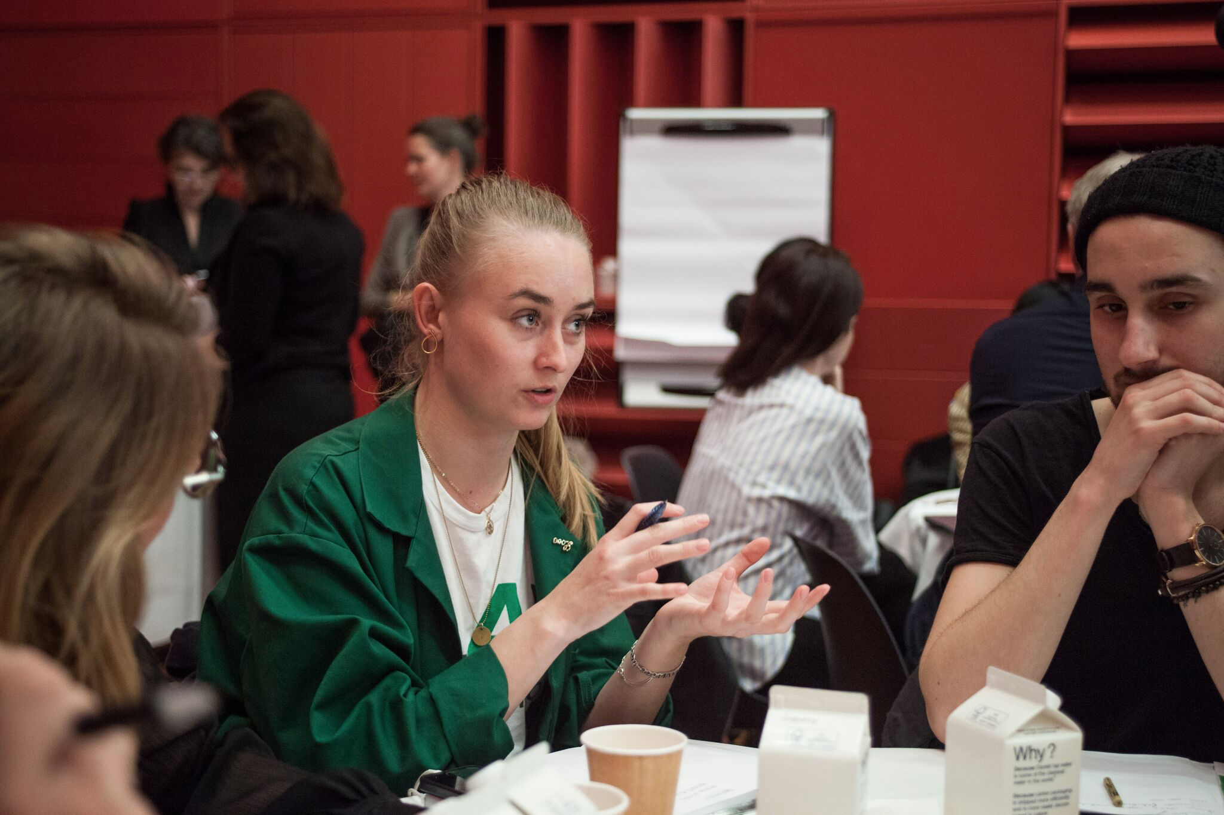
Have Fun!
And see you soon!

